Slide 1
Trash-go waste
MAKE INDIA A WASTE FREE COUNTRY

Slide 2
Group members
Rahul Jayan
Ranjana A
Reena Thomas
Renin Joy

Slide 3
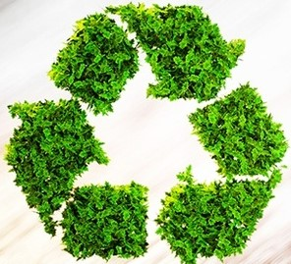
introduction
This is an app intended for the people who have difficulty in disposing of waste and to protect the environment in general.
This app when released to the public would be a great help and would be are evolutionary idea in our society .

Slide 4
Existing system
Nowadays there are municipality workers who come and take away the waste from our houses and surroundings.
But the main problem is that the workers only come once a month and that is not something that is sufficient in a normal Indian household.
Also there are dustbins , but only in some corners of the cities.
This situation needs to change especially in a developing country like India . We need more technologies to counter this problem .

Slide 5
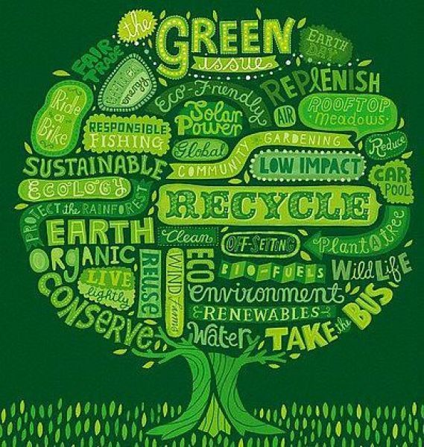
advantages
Helps to maintain the environment neat and clean .
Waste energy is basically a derivative of some techniques of waste management.
Although incineration releases huge amounts of carbon dioxide as well as other pollutants, modern advances have been available to capture the power being produced in incineration and utilize it to generate electricity.
The end outcome is an intricate approach to reusing items to lower the need of future waste.

Slide 6
DISADVANTAGES
The process is not always cost-effective.
Places to recycle and dispose waste material after segregation is less in India.
Waste management if not done properly can cause many diseases .
Without internet app cannot work properly .
Maintenance cost is high.

Slide 7
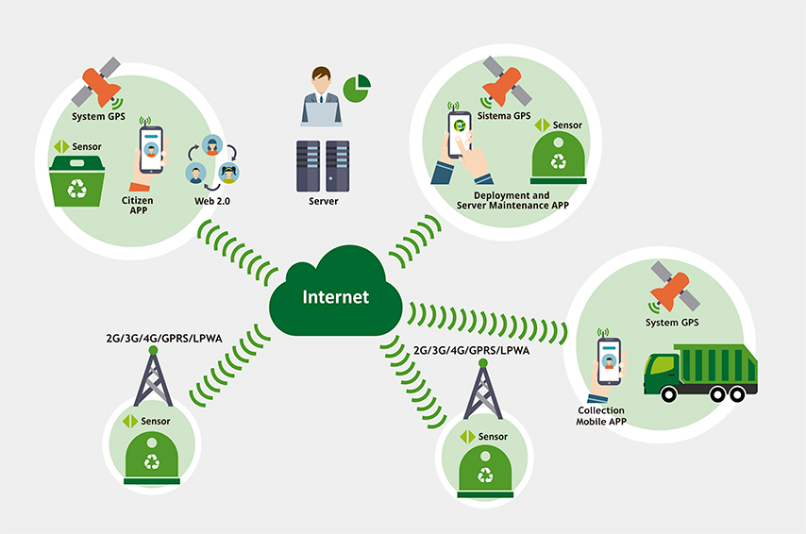
Proposed system

Slide 8
Future scope
This app aims at “WASTE FREE INDIA”
Keeps the environment clean and fresh.
Saves the Earth and conserves energy.
Reduces ecological contamination
Provides jobs to poor people.
Correct disposal of waste at correct places.

Slide 9
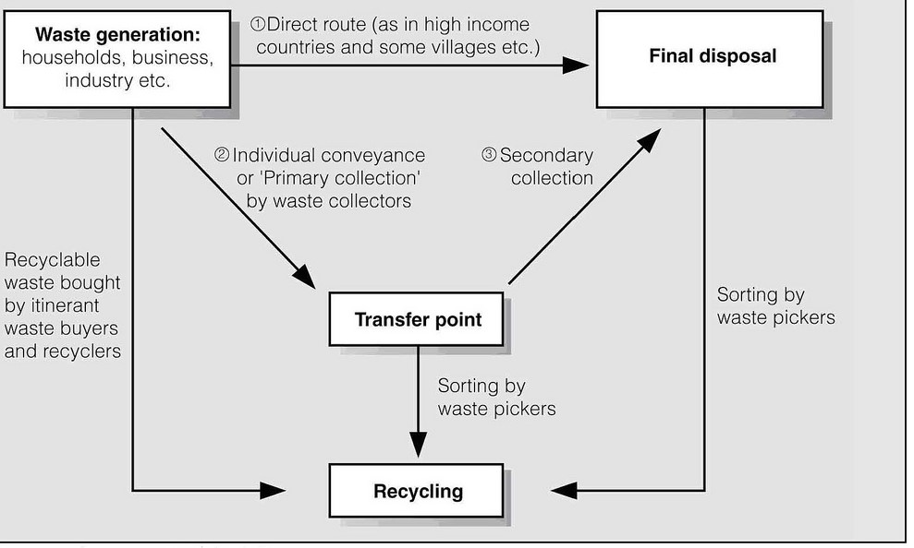
Block diagram

Slide 10
conclusion
Proper disposal of waste or waste management relocates waste to places where they can be left, incinerated or disposed of in a safe manner.
Removing waste from public areas assists in easing risks to all around health, decreases exposure to biohazards and reduces infestation of pest.
The easier solution is to collect and dump. Or to believe that unsegregated waste can be sorted out mechanically at the processing plant itself and burnt.
This app will be implemented with a system where the users are reward for the waste they have handed over to be dumped or according to the quantity of the waste.

Slide 11


